Slide 1
Digital Egypt Pioneers Initiative (DEPI)
Logistics Performance Analysis
Capstone Project — CAI4_DAT2_S1 [R4]
Track: Data Analytics
Major: Microsoft Power BI Specialist
Instructor: Mahmoud Seraj

Slide 2
Project Overview & Objectives
Project Objective
Central Challenges
This project analyzes two full years of delivery operations data spanning January 2023 through December 2024 for a logistics network operating across six distribution hubs. The dataset covers 25,852 individual delivery orders, involving 53 drivers, 45 vehicles, and six hub locations.
Using Microsoft Power BI as the primary analytics platform, the project transforms raw operational data into a suite of interactive dashboards designed to give decision-makers at all levels a clear, real-time view of network performance and improvement opportunities.
Delay rate of 20.4% across all delivered orders
Aging vehicle fleet contributing to frequent breakdowns
Uneven workload distribution across hubs
Absence of centralized system for tracking driver-level performance
25,852
20.4%
Total Orders
Delay Rate
Across all six hubs, January 2023 – December 2024
5,219 orders delivered late across the two-year period
84.4%
73.33%
CSAT Score
Active Vehicles
Percentage of orders receiving a score of 4 or 5
33 out of 45 vehicles available for dispatch
2

Slide 3
Project Methodology
01
02
Data Preparation
Data Modeling
Four source CSV files imported and processed using Power Query. Standardized date formats, renamed columns for consistency, handled null values, and created calculated columns: Vehicle Age, Driver Tenure, and Experience Segment.
Constructed star schema with Orders table at center as fact table. Drivers, Hubs, and Vehicles tables connected as dimension tables via matching keys. Ensures filters propagate correctly across all visuals.
03
04
Exploratory Data Analysis
Dashboard Development
Studied relationships between driver experience and delivery performance, analyzed vehicle age versus breakdown frequency, examined delivery time effects on customer satisfaction, and identified peak order months.
Built nine interactive report pages in Power BI, each targeting specific audience and analytical questions. All pages include slicers for Year, Month, Hub, Vehicle Type, and Driver Name with MoM comparisons.
Stakeholder Analysis
Understanding who uses the dashboards and what metrics matter most to their decision-making:
Stakeholder
Role
Key Metrics Needed
Logistics Operations Manager
Strategic decision-maker
Network-wide KPIs, hub performance comparisons, monthly trends across full two-year period
Hub Supervisors
Operational management
Hub processing time and correlation with CSAT, ranking, workload rebalancing
Driver Manager
Driver performance oversight
Driver performance ratings, top delayed orders by driver name, individual driver drill-down profiles
Fleet Manager
Vehicle and maintenance oversight
Breakdown rates by vehicle model, current maintenance rate, active versus unavailable fleet status
3

Slide 4
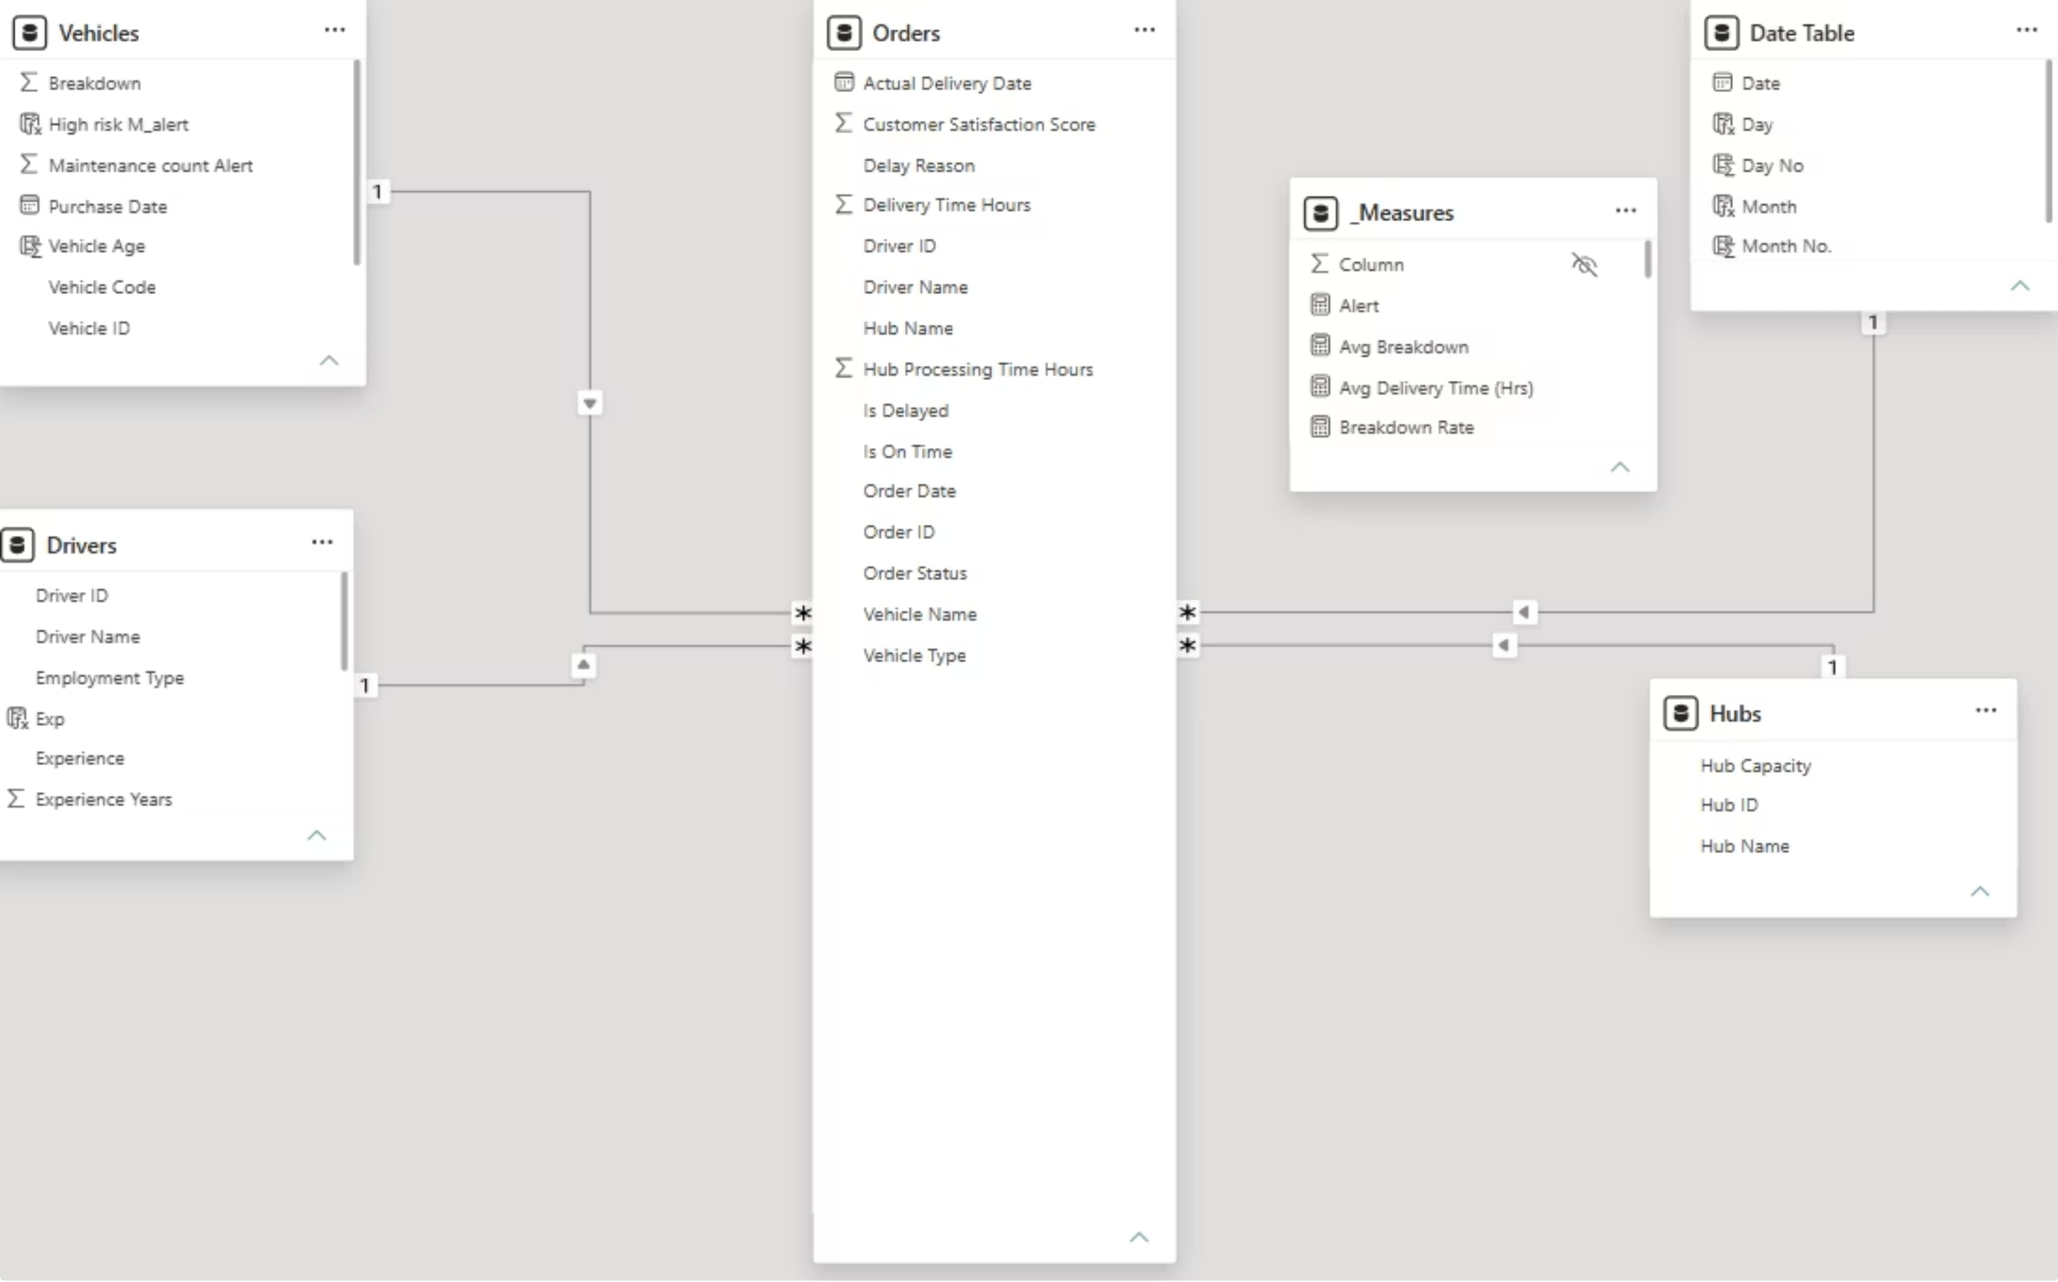
Dataset Overview & Structure
All data provided as CSV files covering January 2023 to December 2024. Dataset structured across four tables describing every aspect of logistics operations:
Table
Records
Description
Orders
25,852
Central fact table — one row per delivery order
Drivers
53
One row per driver with employment and performance data
Vehicles
45
One row per vehicle with status and breakdown history
Hubs
6
One row per hub with location and capacity
Data Modelling and Relationships:
The four tables are connected using a star schema. The Orders table serves as the central fact table, while Drivers, Vehicles, and Hubs act as dimension tables connected to it via their respective keys. This architecture ensures that any filter applied on the report — such as selecting a specific hub or a date range — automatically propagates to all visuals across the page.
4

Slide 5
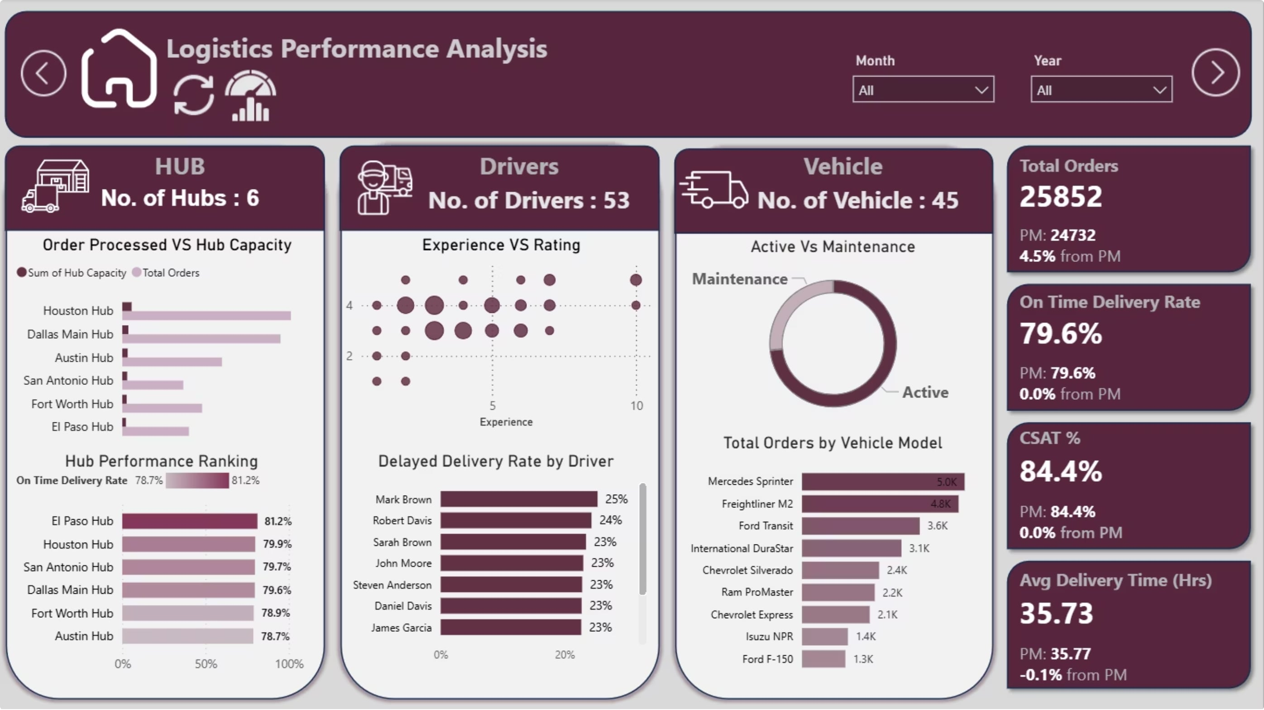
Overview Dashboard
Hub utilization imbalance: Gap between hub capacity and actual orders, especially in Dallas and Houston, indicating inefficient resource use.
Best vs worst hub: El Paso has the highest on-time delivery rate (~81%), while Austin is the lowest (~78.7%), pointing to operational issues.
Driver performance variation: A few drivers have high delay rates (~24–25%), hurting overall efficiency.
Around 73.33% of vehicles are active, while 26.7% are under maintenance.
This is a relatively high maintenance ratio and may affect delivery capacity and speed.
Network-Wide Performance Metrics
On-Time Delivery Rate
79.6% network-wide OTD
Approximately 1 in 5 orders delayed
Average Delivery Time
35.73 hours from order to delivery
On-time: 35.59 hrs | Delayed: 42.48 hrs
Customer Satisfaction
4.17/5 average score
84.4% of orders rated 4 or 5
5

Slide 6
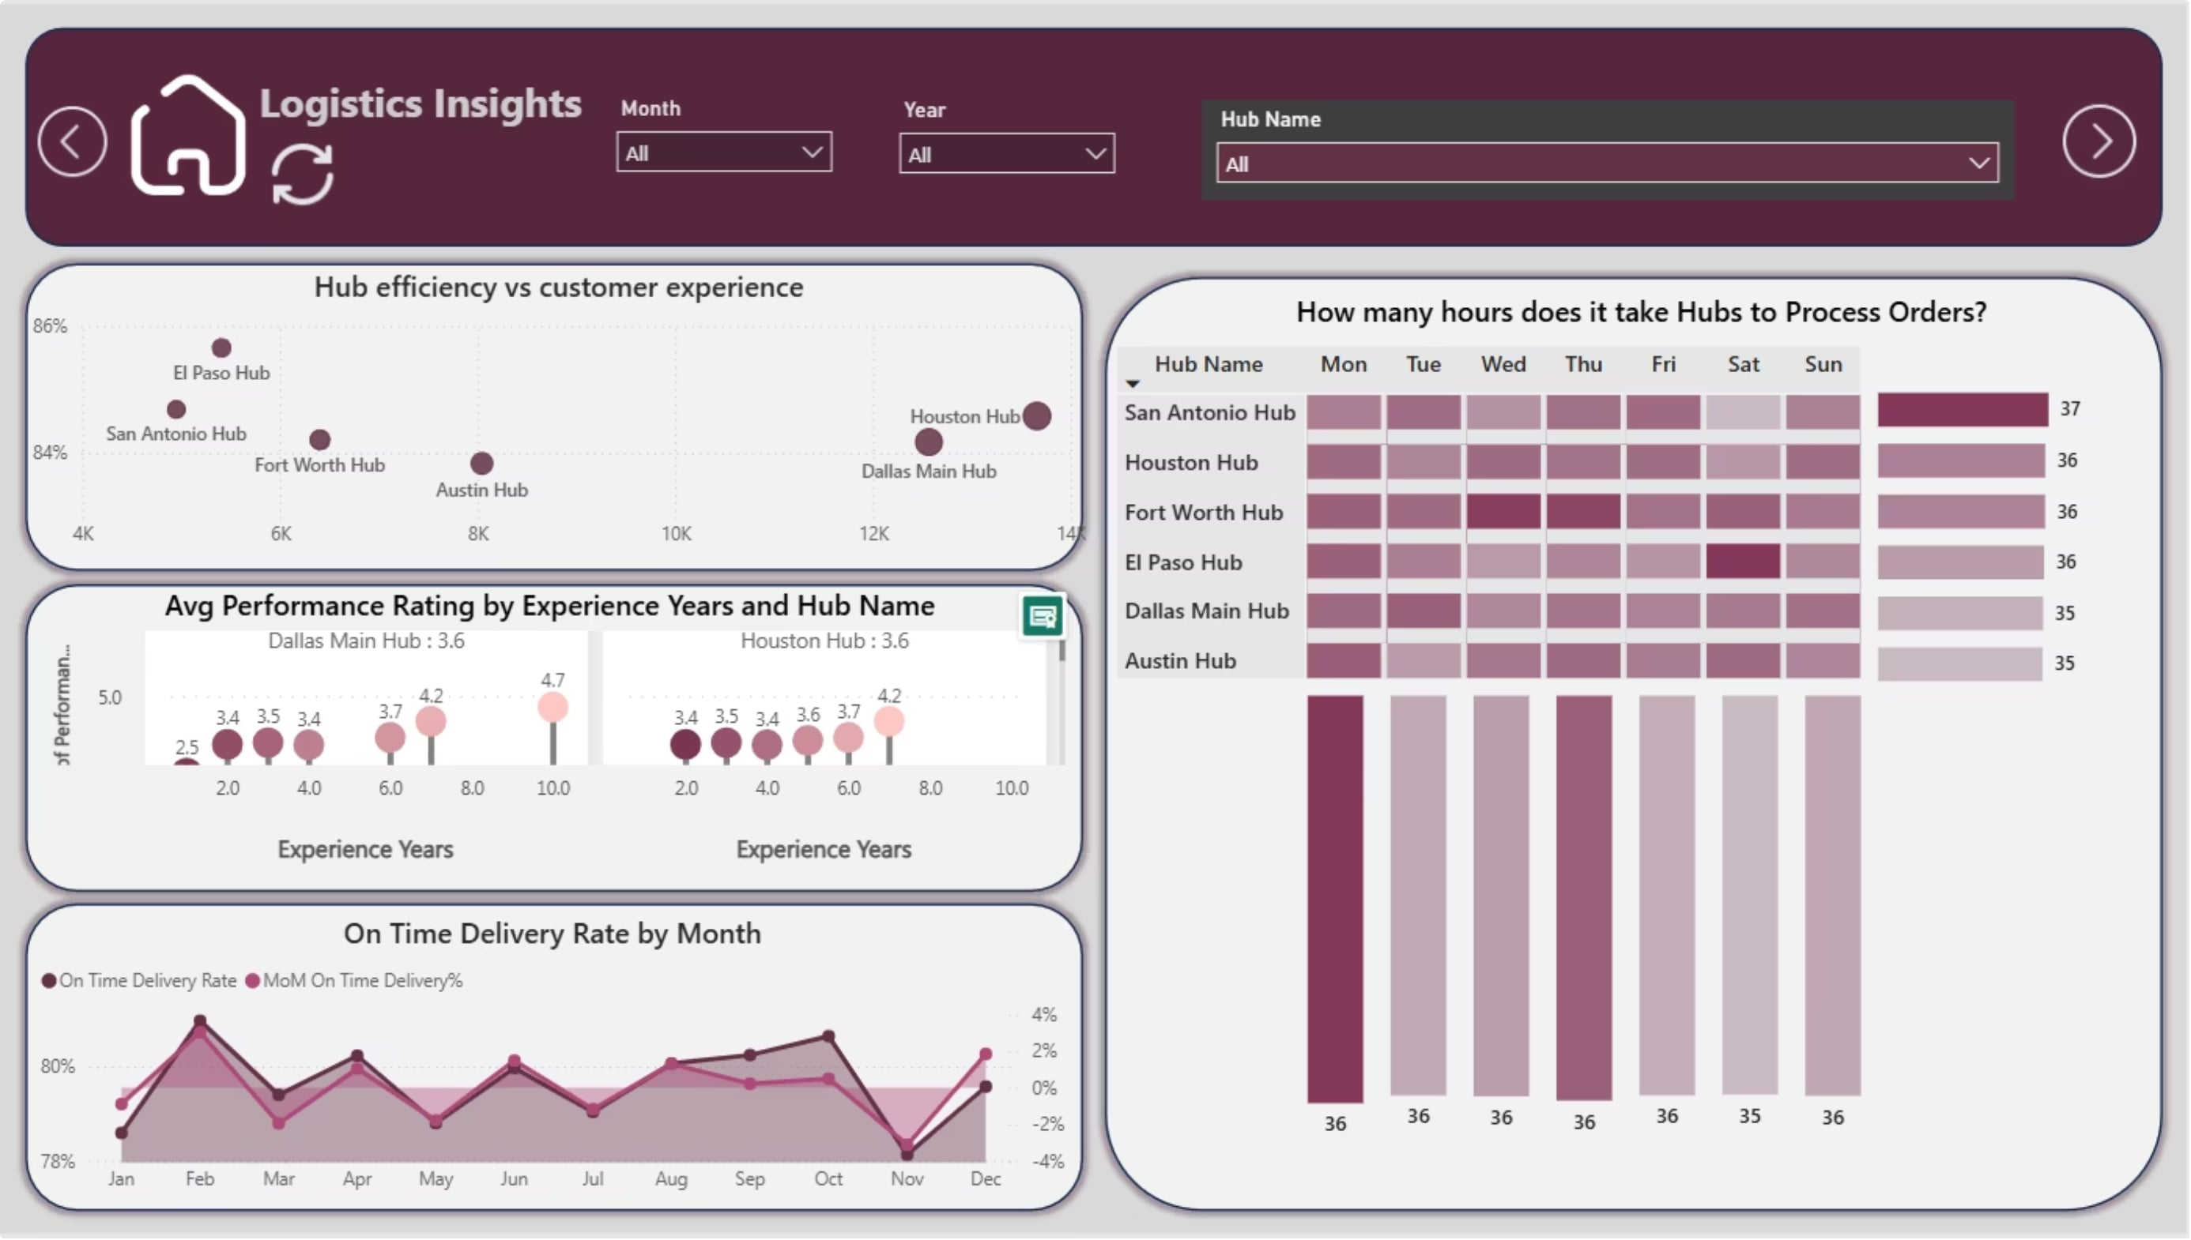

Hub Performance Analysis
How to read it: Start with the bar chart to see which hub has the highest absolute delay count. Move to the scatter to understand whether that hub's delays correlate with longer processing times. Use the matrix to identify which day of the week creates the worst bottleneck. The line chart at the bottom shows whether hub performance is improving or declining over time.
Why it matters: Hub-level delay data often reveals that individual driver delay counts are partially determined by the hub they are assigned to. Before attributing high delay counts to a driver, check whether other drivers at the same hub show similar patterns.
Key Finding: Hub processing time matrix reveals Mondays show consistently longer processing times at El Paso Hub (37 hours) compared to network's typical 35-36 hours, signaling mid-week capacity constraint.
6

Slide 7
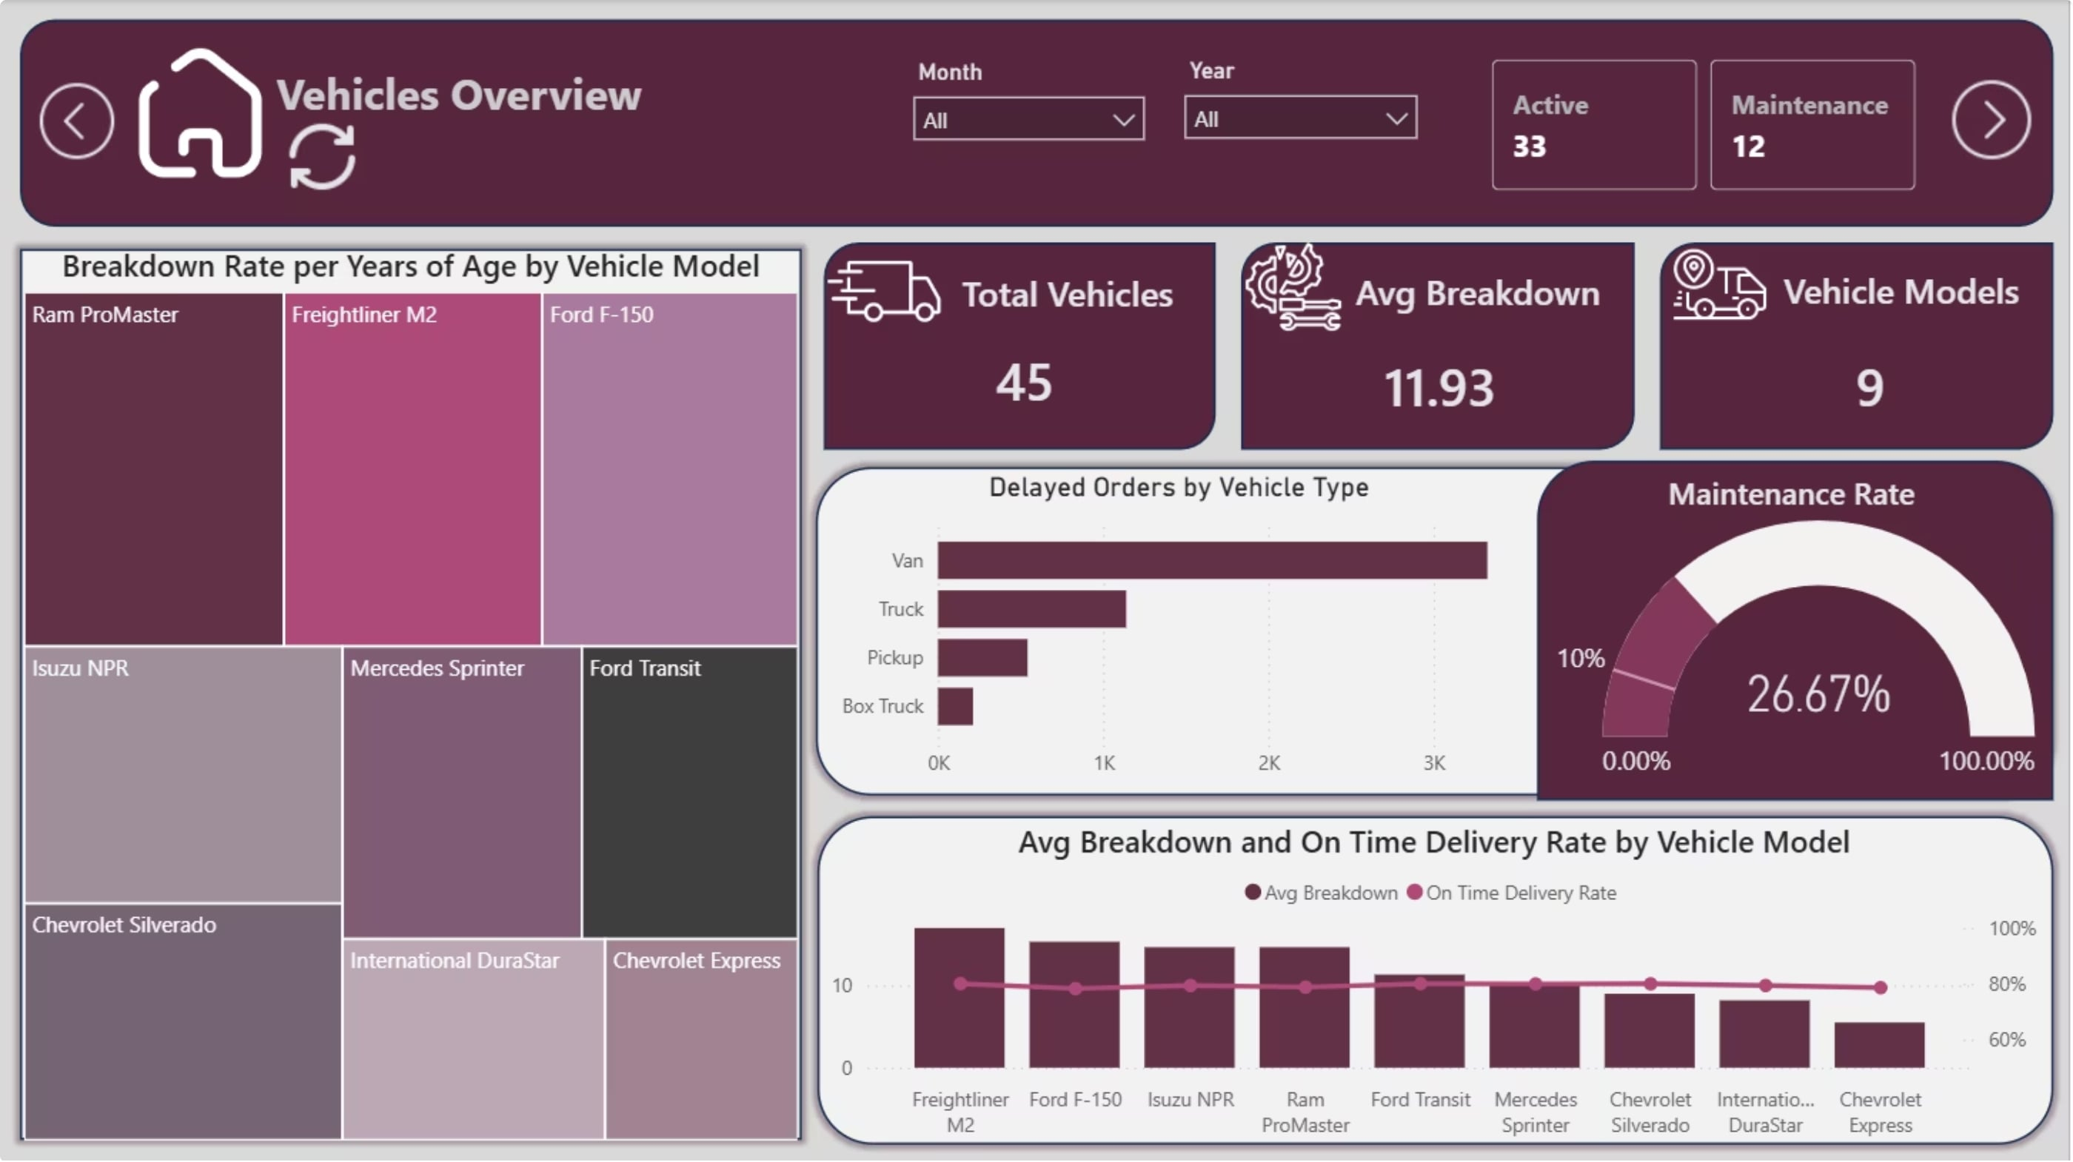
Vehicles Overview
The fleet consists of 45 vehicles across 9 models, providing operational flexibility.
26.7% of vehicles are under maintenance, reducing available fleet capacity.
Vans record the highest delayed order volume, suggesting heavier operational demand.
Breakdown rates vary by vehicle model, with Freightliner M2 and Ford F-150 showing the highest maintenance needs.
Models with fewer breakdowns generally achieve better on-time delivery performance.
Model
Count
Avg Breakdowns
Freightliner M2
9
17.0
Ford F-150
3
15.3
Isuzu NPR
3
14.7
Ram ProMaster
3
14.7
Mercedes Sprinter
9
10.2
Chevrolet Express
4
5.5
7

Slide 8
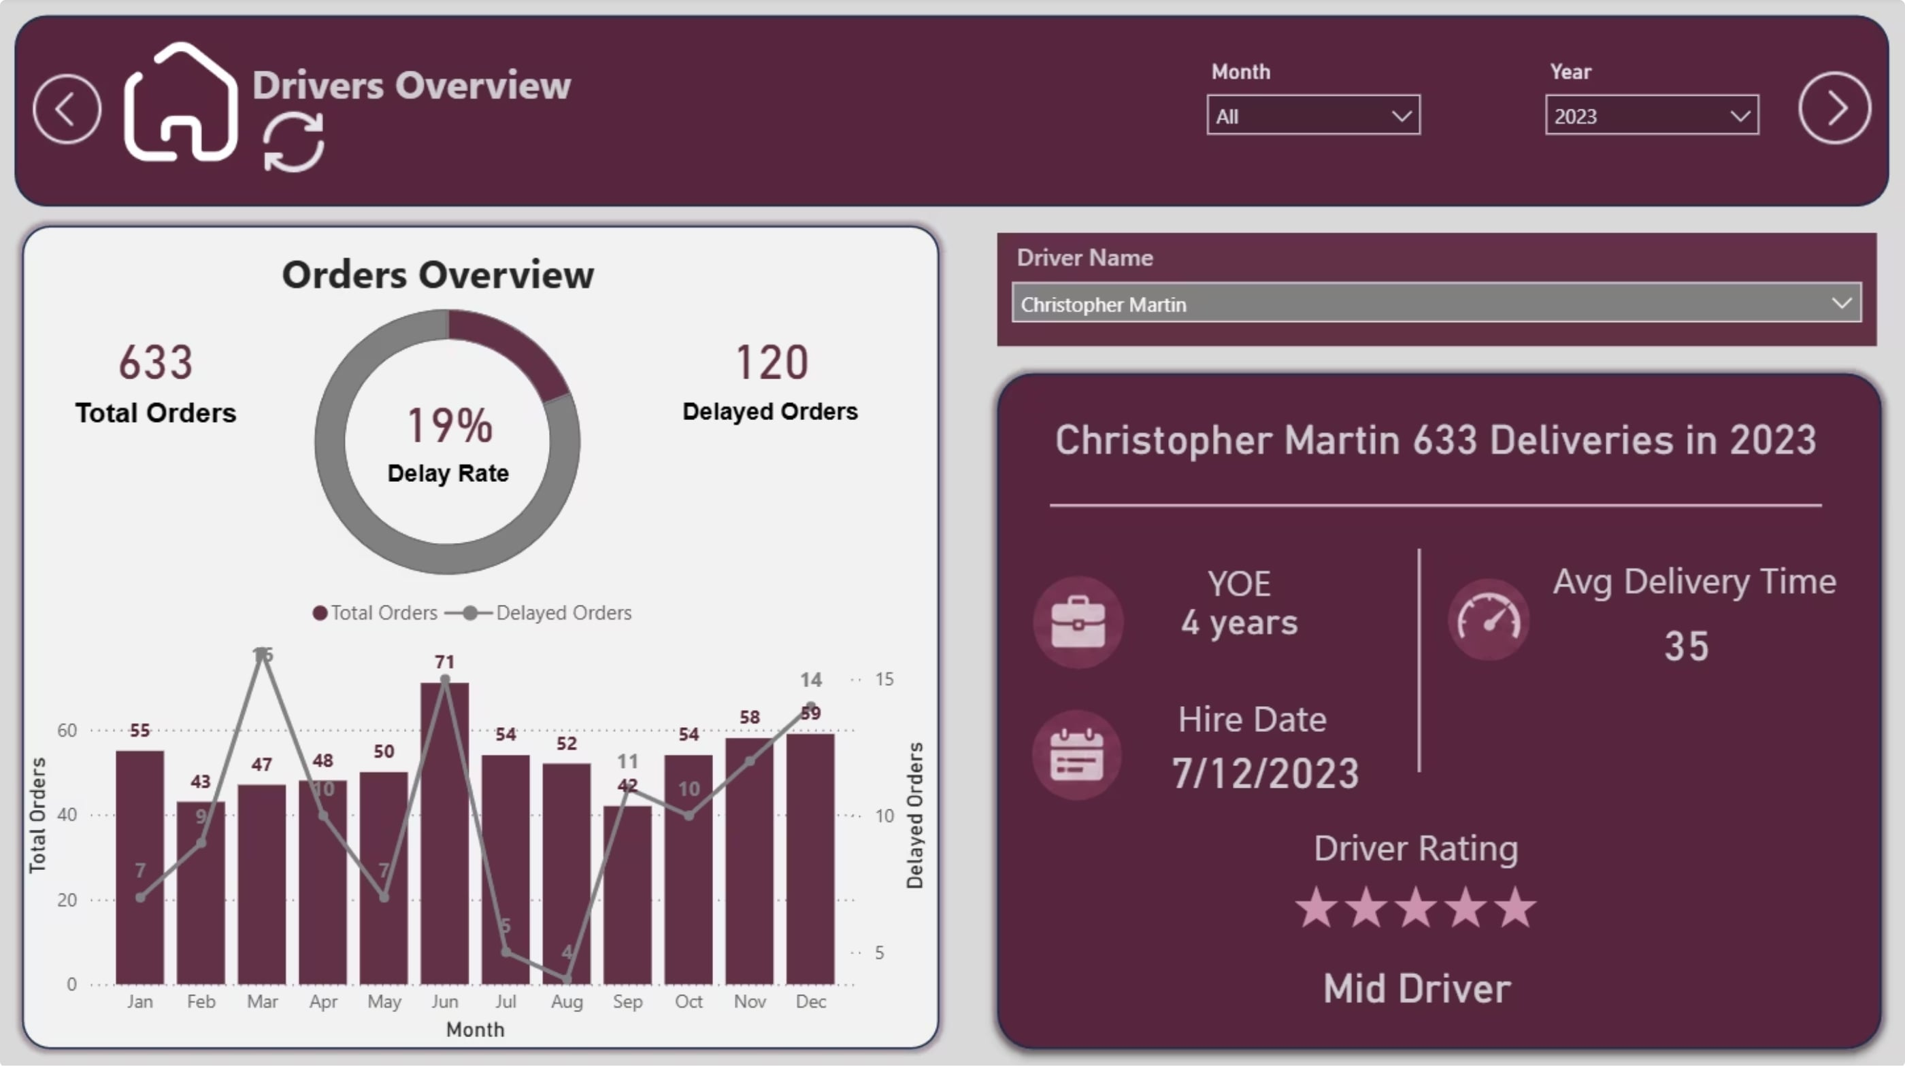
Drivers Overview
This section highlights individual driver profiles and performance metrics. It includes driver name, hire date, and years of experience (YOE), which help assess each driver’s capability. The average delivery time is 35 hours, and the delayed delivery rate is 19%, indicating variation in efficiency and reliability across drivers.
Some drivers have higher numbers of delayed orders, with Christopher Martin recording the highest delays.
YEAR 2023 FILTER APPLIED
Top Delay Causes
Vehicle Fleet Status
Vehicle Breakdown: 578 cases (controllable through maintenance)
Road Construction: 565 cases (external factor)
Hub Processing Delays: 540 cases
Weather Conditions: 535 cases
Total Vehicles: 45 across 9 models
Active: 33 (73.33%)
Under Maintenance: 12 (26.67%)
Average Age: 5.2 years
8

Slide 9

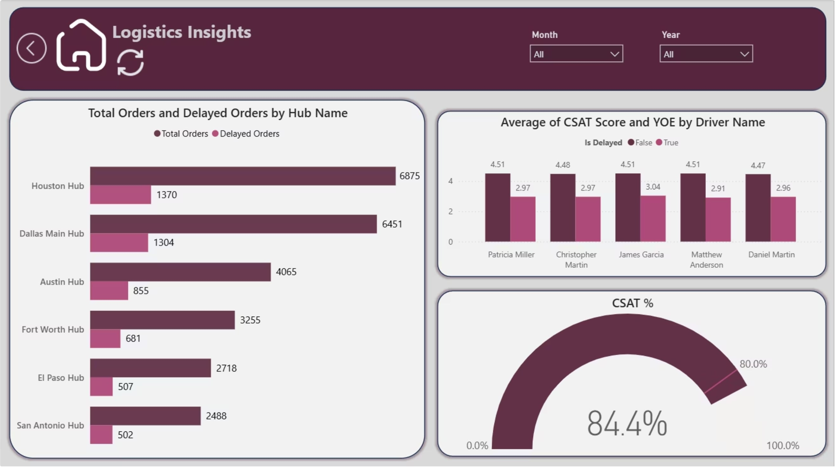
Logistics Insights
Order Volume & Delays by Hub
The bar chart on the left shows total orders and delayed orders across six distribution hubs:
Houston Hub leads with 6,873 total orders but also has the highest delayed count (1,570), indicating a significant bottleneck
San Antonio Hub has the smallest operation (962 orders)
Key Insight: Houston and Dallas are struggling with delay management despite high order volumes, suggesting capacity or operational efficiency issues.
CSAT Performance by Driver
The bar chart on the right displays Average CSAT Score and YOE (Years of Experience) by driver name:
Across the listed drivers, average CSAT scores remain strong (around 4.47 to 4.51) when orders are delivered on time.
However, when an order is delayed, those scores drop significantly (down to approximately 2.91 to 3.04).
Experience levels don't appear to directly correlate with CSAT scores
Key Insight: Driver Experience alone doesn't guarantee customer satisfaction.
Overall CSAT Score: 84.4%
The gauge chart shows that 84.4% of orders resulted in satisfied customers, which is solid but leaves room for improvement. Given the high delay rates in major hubs, this suggests customers are somewhat tolerant, but further improvements could push satisfaction higher.
Strategic Takeaway: Focus operational improvements on Houston and Dallas hubs to reduce delays and boost the overall CSAT score above 85%.
9

Slide 10
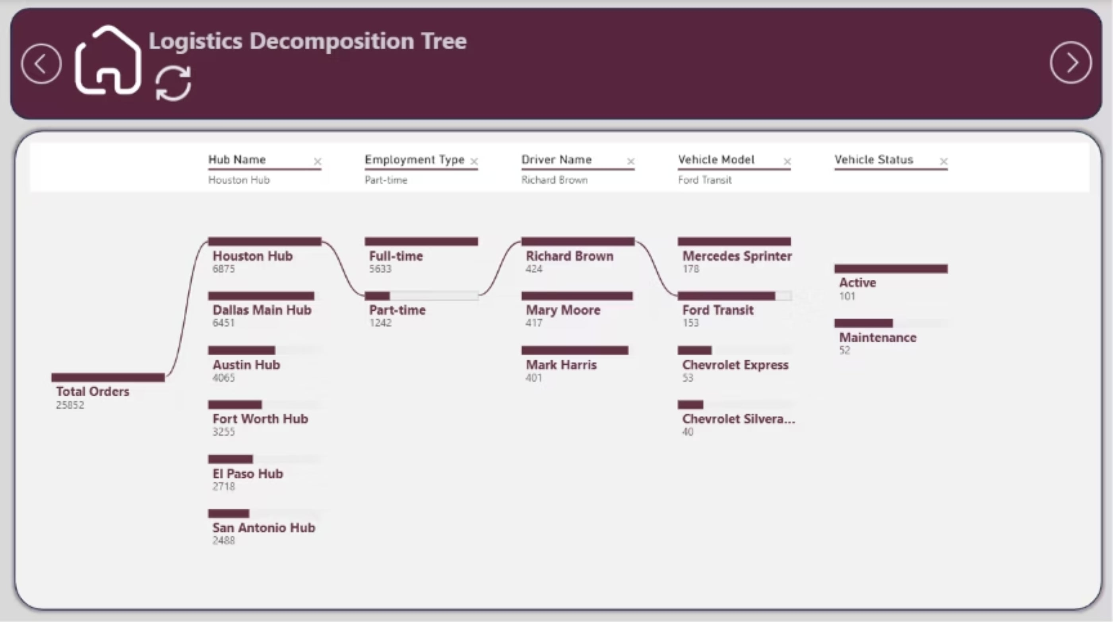
Logistics Decomposition Tree Analysis
This dashboard features a Decomposition Tree visual, which is used to break down Total Orders (25,852) into subcategories to analyse distribution and drill down into specific scenarios.
Highlighted Drill-Down Path
The current view traces a step-by-step path through the data hierarchy:
Hub Name: Starts with the Houston Hub, which accounts for 6,875 of the total orders.
Employment Type: The orders split between Full-time (5,633) and Part-time (1,242) drivers. The tree follows the Part-time branch.
Driver Name: Richard Brown is highlighted, having handled 424 of those orders.
Vehicle Model: Richard Brown's 424 orders are further divided by the vehicle he drove. The path selects the Ford Transit (153 orders).
Vehicle Status: The tree shows that 101 orders were associated with Active vehicles, while 52 were Maintenance vehicles.
Strategic Implications
This decomposition reveals the interconnection of logistics operations. Changes in one hub affect overall network performance. CSAT scores depend on optimizing all three layers: hubs, drivers, and vehicles.
10

Slide 11
DAX Metrics: Order Volume Calculations
These measures track order volume across the network and support month-over-month analysis.
Total Orders
Total Orders = COUNT(Orders[Order ID])
Business Meaning: Counts all orders in the dataset, including delivered, delayed, and cancelled orders.
PM Orders (Previous Month Orders)
PM Orders = CALCULATE([Total Orders], DATEADD('Date Table'[Date], -1, MONTH))
Business Meaning: Returns the total order count for the previous calendar month. It serves as the comparison base for MoM calculations.
MoM Orders %
MoM Orders % = DIVIDE([Total Orders] - [PM Orders], [PM Orders])
Business Meaning: Shows the month-over-month change in order volume as a percentage. Positive values indicate growth; negative values indicate decline.
Delivered Orders
Delivered Orders = CALCULATE([Total Orders], Orders[Order Status] = "Delivered")
Business Meaning: Counts only orders marked as delivered. Use this as the base for delivery performance metrics.
Date Table Enhancements
Two calculated columns enable day-of-week analysis in hub processing time matrices.
Day (Calculated Column)
Day No (Calculated Column)
Day = FORMAT('Date Table'[Date], "ddd")
Day No = WEEKDAY('Date Table'[Date], 2)
Business Meaning: Formats each date as a three-letter day abbreviation (Mon, Tue, Wed, etc.) for matrix column headers.
Business Meaning: Assigns numeric values (1 = Monday through 7 = Sunday) to enable correct weekday sorting instead of alphabetical order.
11

Slide 12
Delivery Performance Metrics
These measures track delivery timeliness and month-over-month performance.
On Time Delivered Orders
On Time Delivered Orders = CALCULATE([Total Orders], Orders[Delivery Status] = "On Time")
Business Meaning: Counts orders delivered on time.
On Time Delivery Rate (OTD%)
On Time Delivery Rate (OTD%) = DIVIDE([On Time Delivered Orders], [Delivered Orders])
Business Meaning: Measures the share of delivered orders that arrive on time.
PM On Time Delivery Rate
PM On Time Delivery Rate = CALCULATE([On Time Delivery Rate (OTD%)], DATEADD('Date Table'[Date], -1, MONTH))
Business Meaning: Returns the prior month's on-time delivery rate for comparison.
MoM On Time Delivery %
MoM On Time Delivery % = DIVIDE([On Time Delivery Rate (OTD%)] - [PM On Time Delivery Rate], [PM On Time Delivery Rate])
Business Meaning: Shows the month-over-month change in on-time delivery rate.
12

Slide 13
CSAT Metrics
These measures track customer satisfaction and month-over-month performance.
CSAT Satisfied Orders
CSAT Satisfied Orders = CALCULATE([Total Orders], Orders[CSAT Status] = "Satisfied")
Business Meaning: Counts orders where customers reported being satisfied.
CSAT %
CSAT % = DIVIDE([CSAT Satisfied Orders], [Total Orders])
Business Meaning: Measures the share of total orders that received a satisfied CSAT response.
PM CSAT %
PM CSAT % = CALCULATE([CSAT %], DATEADD('Date Table'[Date], -1, MONTH))
Business Meaning: Returns the prior month's CSAT percentage for comparison.
MoM CSAT %
MoM CSAT % = DIVIDE([CSAT %] - [PM CSAT], [PM CSAT])
Business Meaning: Shows the month-over-month change in CSAT percentage.
13

Slide 14
Time Metrics
These measures track delivery duration and how it changes over time.
Avg Delivery Time (Hrs)
Avg Delivery Time (Hrs) = AVERAGE(Orders[Delivery Time Hours])
Business Meaning: Calculates the average hours from order placement to delivery. Lower values indicate faster fulfillment.
PM Avg Delivery Time
PM Avg Delivery Time = CALCULATE([Avg Delivery Time (Hrs)], DATEADD('Date Table'[Date], -1, MONTH))
Business Meaning: Returns the prior month's average delivery time for comparison.
MoM Avg Delivery %
MoM Avg Delivery % = DIVIDE([Avg Delivery Time (Hrs)] - [PM Avg Delivery Time], [PM Avg Delivery Time])
Business Meaning: Shows the percentage change in delivery time versus prior month. Positive values indicate slower delivery (unfavorable).
Year Month Title
Year Month Title = SELECTEDVALUE('Date Table'[Month]) & " " & SELECTEDVALUE('Date Table'[Year])
Business Meaning: Generates a dynamic text title showing the selected month and year (e.g., 'June 2023') for dashboard headers.
14

Slide 15
Vehicle Metrics
These measures track fleet health and identify vehicles requiring maintenance attention.
Total Vehicles
Total Vehicles = COUNT(Vehicles[Vehicle ID])
Business Meaning: Counts the total number of vehicles in the fleet (currently 45 across nine models).
Avg Breakdown
Avg Breakdown = AVERAGE(Vehicles[Breakdown])
Business Meaning: Calculates the average breakdowns per vehicle. Current fleet average is 11.93 breakdowns per vehicle.
Vehicle Age (Calculated Column)
Vehicle Age = YEAR(TODAY()) - YEAR(Vehicles[Purchase Date]) & " years"
Business Meaning: Computes each vehicle's current age in years. Shows 0.655 correlation with breakdown frequency.
Maintenance Rate
Maintenance Rate = DIVIDE(CALCULATE(COUNT(Vehicles[Vehicle ID]), Vehicles[Vehicle Status] = "Maintenance"), COUNT(Vehicles[Vehicle ID]))
Business Meaning: The percentage of vehicles currently in maintenance status (currently 26.67%).
Breakdown Rate
Breakdown Rate = DIVIDE(SUM(Vehicles[Breakdown]), SUM(Vehicles[Vehicle Age]), 0) + 0
Business Meaning: Measures the frequency of vehicle failures over time. Higher values indicate fleet reliability issues.
High Risk Alert
High Risk Alert = IF([Breakdown Rate] > 2.5, "High Risk", "Normal")
Business Meaning: Flags vehicles or fleet segments as "High Risk" when breakdown rate exceeds 2.5
15

Slide 16
Dynamic Labels & Titles
These measures are designed to create dynamic text labels and titles for various visuals and page headers, enhancing the interactivity and readability of reports.
5.7 Hub Metrics
These measures generate dynamic text labels for hub-related visuals and page headers.
No of Hubs
No of Hubs = "No of Hubs: " & COUNT(Hubs[Hub ID])
Business Meaning: Creates a dynamic text string displaying the hub count (e.g., 'No of Hubs: 6') for summary cards.
Hub Title
Hub Title = "How many hours does it take Hubs to Process Orders?"
Business Meaning: Static text measure used as the dynamic title for the hub processing time matrix.
16

Slide 17
5.8 Driver Metrics
These measures generate dynamic text labels for driver-related visuals and page headers.
Star Rating
No of Drivers
Driver Title
Star Rating = REPT(UNICHAR(9733), AVERAGE(Drivers[Performance Rating])) & REPT(UNICHAR(9734), 5 - AVERAGE(Drivers[Performance Rating]))
No of Drivers = "No of Drivers: " & COUNT(Drivers[DriverID])
Driver Title = SELECTEDVALUE(Drivers[DriverName]) & " made " & [Total Orders] & " Deliveries in " & SELECTEDVALUE('Date Table'[Month]) & " " & SELECTEDVALUE('Date Table'[Year])
Business Meaning: Creates a dynamic text string displaying the driver count (e.g., 'No of Drivers: 55') for summary cards.
Business Meaning: Displays average driver performance rating as filled and empty stars (e.g., ★★★★☆).
Business Meaning: Dynamic title for driver overview showing selected driver's name, order count, and month/year.
YOE (Years of Experience)
YOE = "YOE: " & SELECTEDVALUE(Drivers[Experience Years]) & " years"
Business Meaning: Dynamic text label showing selected driver's years of experience in readable format.
Hire Date Title
Driver Name Title
Hire Date Title = "Hire date: " & SELECTEDVALUE(Drivers[Hire Date])
Driver Name Title = "Driver name: " & SELECTEDVALUE(Drivers[DriverName])
Business Meaning: Dynamic text label displaying the selected driver's hire date in user-friendly format.
Business Meaning: Dynamic text label displaying the selected driver's name in user-friendly format.
17

Slide 18



Summary of Key Findings
One in Five Orders is Delayed
The network delay rate is 20.4%, meaning 5,219 out of 25,852 orders were delivered late during the two-year period. The two most frequent delay causes Road Construction and Vehicle Breakdown
However, Road Construction is an external factor while Vehicle Breakdown is entirely within the company's control through preventive maintenance and fleet renewal.
1
Customer Satisfaction is Strong but Sensitive to Delivery Speed
The network maintains a healthy overall customer satisfaction rate of 84.4%. However, there is a drop in satisfaction when orders are delayed. While on-time deliveries consistently earn high scores—averaging approximately 4.5 out of 5 across drivers—delayed orders see those scores plummet to roughly 3.0 out of 5. This significant drop confirms that meeting delivery expectations is directly tied to maintaining a positive customer experience.
2
Hub Workload is Significantly Uneven
Dallas Main Hub processes 6,451 of all network orders — the highest volume of any hub — despite not holding the largest capacity in the network. El Paso Hub handles the fewest orders (2,718) and achieves the best OTD rate (81.2%), reinforcing the hypothesis that order pressure affects delivery performance. Rebalancing workload from high-pressure hubs to under-utilized ones could improve network-wide OTD rates.
3
Driver Performance and Customer Satisfaction are Highly Consistent
4
The dashboard tracks both CSAT scores and Years of Experience (YOE) across the driver pool, the data reveals that performance outcomes are remarkably uniform regardless of the individual driver. Across the sampled drivers, customer satisfaction results are nearly identical. This indicates that individual driver profiles or experience levels do not significantly alter customer satisfaction; rather, the timeliness of the delivery itself is the universal deciding factor.
Fleet Health is a Critical Operational Risk
26.67% of the fleet — 12 out of 45 vehicles — is unavailable for dispatch at any given time. The average breakdown count across the fleet is 11.93 per vehicle, and vehicle age is a meaningful predictor of breakdown frequency. Freightliner M2 vehicles average 17.0 breakdowns each, while the oldest vehicles in the fleet are 8 years old. This level of fleet unreliability directly contributes to Vehicle Breakdown being one of the top two delay causes.
5
18

Slide 19





Strategic Recommendations
Plan Ahead for Peak Months
May and October are highest-volume months every year. Hire additional contract drivers in advance and clear maintenance backlogs before volume surges to protect OTD rates and CSAT scores.
Shift Driver Evaluation to Outcome-Based Metrics
Experience years do not predict performance (correlation: 0.006). Evaluate drivers on actual OTD rate, delay count, and CSAT score over rolling six-month period instead of experience.
Implement Vehicle Retirement Policy
Place vehicles 7+ years old with 20+ breakdowns on immediate retirement schedule. Set preventive maintenance milestones at breakdown count thresholds rather than calendar intervals.
Rebalance Hub Workload
Route portion of Dallas Main Hub's volume to underutilized hubs — particularly Fort Worth and El Paso. El Paso's superior OTD rate at lower volumes suggests room to absorb additional orders.
Coach Using Cross-Referenced Evidence
Before assigning coaching to top 10 highest-delay drivers, cross-reference delay records against vehicle breakdown data. If delays correlate with vehicle history, problem may be fleet-related rather than driver-related.
19

Slide 20
Project Team:
Team Member
Contribution
Jana El Naggar
Data Cleaning, Vehicles Analysis Dashboard, Insights and Recommendations & Document.
Shimaa Samy
Overview Dashboard and Home Page, Presentation & Document.
Mariam Hesham
Hubs Analysis Dashboard & Document.
Mariam Mowafy
Drivers Overview Dashboard.
Fatma Ez-zahraa
Documentation.
Project Github Link: Depi2026/Logistics-Project
20

